Slide 1
CIS 2403-object Oriented Programming
Chapter 3
Implementing Association in JAVA
CHAPTER 3 | CLO2: Implementing different types of relationships (Association, Aggregation, Composition) between classes to develop object-oriented solutions.

Slide 2
Document Revision CONTROL (DRC)
Version​ | Author​ | Effective Date​ | Change Description​ | DRC No​
1.0​ | Dr Madeleine Togher | June 2021 | Define the first version​ | 001​
1.1​ | Dr. Nourchene Benayed | June 2021 | Adding examples | 001
X: Major change
Y: Minor change

Slide 3
Lecture Notes
Contents of lectures are based on the textbook, recommended text, and supplementary material
Please read Chapter ??? from page
??? to ???
??? to ???

Slide 4
Lecture OUTLINE
INTRODUCTION
2. WHAT IS ASSOCIATION?
5. N:M ASSOCIATION
KEY TERMS
3. 1:1 ASSOCIATION
4. 1:N ASSOCIATION

Slide 5
LECTURE OBJECTIVES
At the end of lecture, the student should be able to:
Understand the concept of association between classes
Implement Association in Java
Implement 1:1, 1:N, and N:M associations

Slide 6
1. INTRODUCTION
So far we have only developed classes (objects) which are unrelated to each other.
In real life, objects/things are often related in some way to other objects/things.
It would be useful to model relationships between some objects to help us in solving some programming problems
We can use ASSOCIATION to relate our objects/classes together

Slide 7
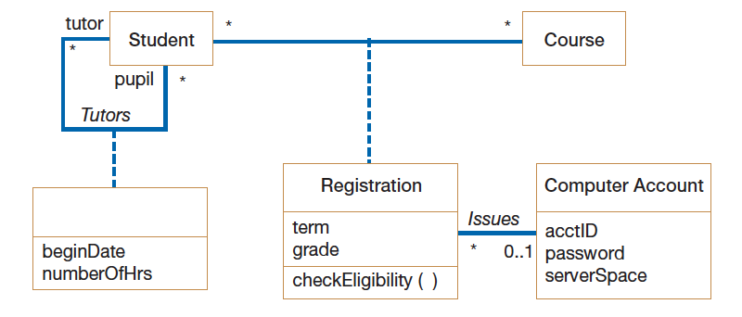
1. INTRodUCTION – Class DIAGRAM
Concepts | Description
Class | Represent a collection of objects sharing the same structure, behaviors, relationships, and semantics
Relationships | Represent a link between or among classes
Notes:
Discuss the relationships between the class in the diagram

Slide 8
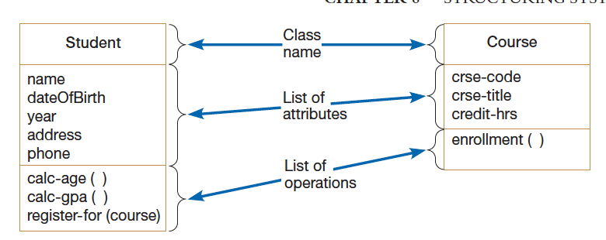
1. INTRodUCTION – Class
A class is a description of a collection of objects sharing the same structure (attributes), behaviors(operations), relationships, and semantics
Attributes are properties describing the state of an instance of class (an object)
Operations are actions or functions that a class can perform
Notes:
Discuss the relationships between the class in the diagram

Slide 9
1. INTRodUCTION – Relationships BETWEEN OBJECTS
Relationship Types
Dependency
Generalization/Specialization
Association
Aggregation
Composition
Association

Slide 10
2. What is Association?
Association is a relationship between two separate classes which establishes through their Objects.
In Object-Oriented Programming, an Object can communicate with another other Object to use its functionality and services provided by that object.
Composition and Aggregation are the two other forms of Association.

Slide 11
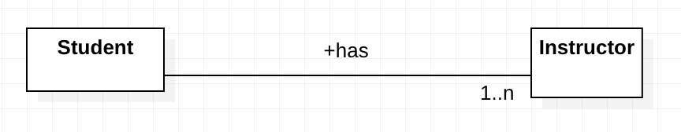
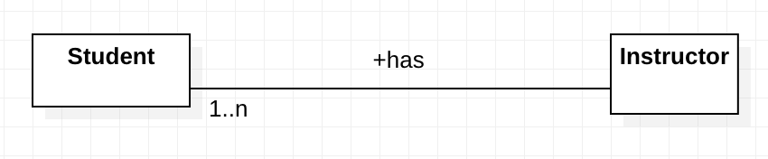
2. What is Association?
Association has a name and multiplicity indicating how many objects participate in a given relationship
The example indicates that a Student has one or more Instructors:
The example indicates that every Instructor has one or more Students:

Slide 12

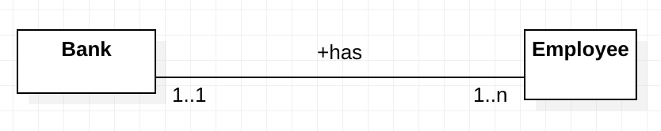
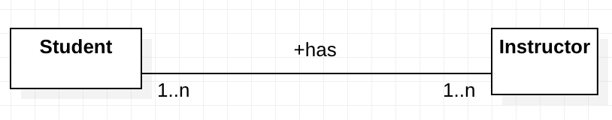
2. What is Association?
ASSOCIATION relationships can be one-to-one, one-to-many, many-to-many
Association | Examples
1:1 One-to-one | A person can have only one passport. A passport belongs to only one Person
1:N One-to-many | If we talk about the association between a Bank and Employee, a bank can have many employees, and an employee work in just one bank
N:M Many-to-many | A student has one or more Instrctors, and an instructor has one or more (many) teachers

Slide 13
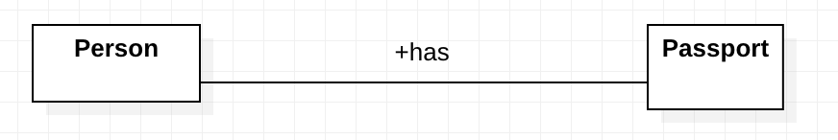
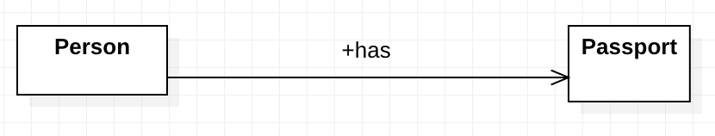
2. What is Association?
ASSOCIATION relationships can be bidirectional or unidirectional (two ways or one way)
Association | Examples
Bidirectional | Associations are always assumed to be bi-directional; this means that both classes are aware of each other and their relationship
Unidirectional | We can limit the navigation by adding a head of arrow. The association becomes unidirectional. In a unidirectional association, two classes are related, but only one class knows that the relationship exists. | Only class Person knows that the relationsip exists

Slide 14
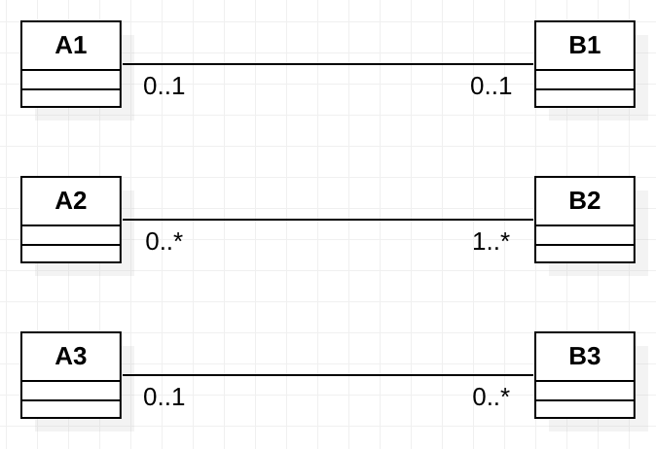
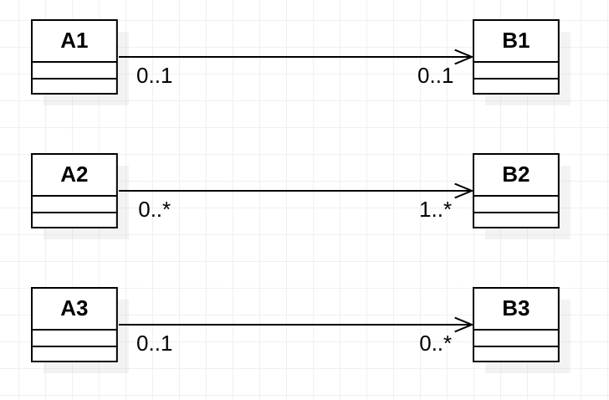
Association
Can be bidirectional or unidirectional (two ways or one way)
Its multiplicity can be 1:1, 1:N, M:N
Notice that classes in association are independent of each other
If an object instance of class Ai is deleted, the instances of class Bi will still exist and vice-versa
Translating the associations into Java code will depend on their multiplicities and directionality
 | Bidirectional – both ways | Unidirectional – one way
1:1
N:M
1:N

Slide 15
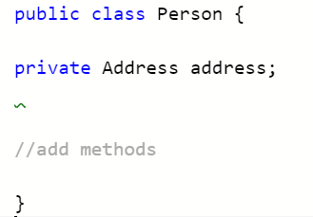
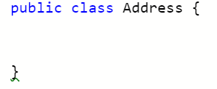
3. 1:1 Association – unidirectional – 1 Way only
Person.java
Address.java
A Person object relates in a unidirectional - one to one association with the Address object. (Association From Person to Address)
The Person class needs an attribute that holds a reference to an object of the other class
The Person object knows about the Address class but the Address class doesn’t know about the Person class
Notes:
A Person object relates 1 to 1 with an Address object

Slide 16
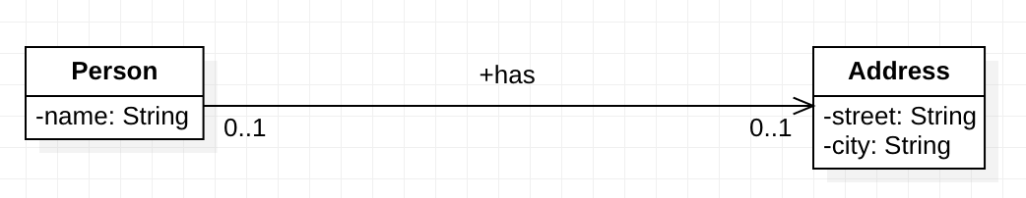
3. 1:1 Association – unidirectional – 1 Way only
Person.java
Address.java
A Person object relates in a unidirectional - one to one association with the Address object. (Association From Person to Address)
The Person class needs an attribute that holds a reference to an object of the other class
The Person object knows about the Address class but the Address class doesn’t know about the Person class
Notes:
A Person object relates 1 to 1 with an Address object

Slide 17
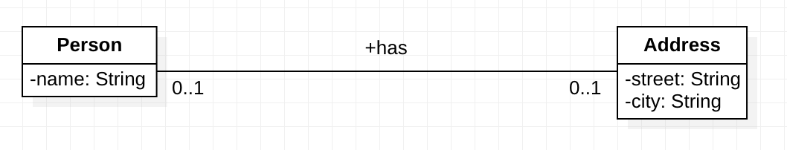
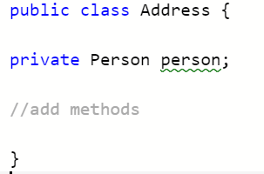
3. 1:1 Association – Bidirectional – 2 Ways
Person.java
Address.java
1 – From Person to Address
2 – From Address to Person
Each class needs an attribute that holds an reference to an object of the other class to create a bidirectional - one to one association (1. from Person to Address) and (2. From Address to Person)
Notes:
A Person object relates 1 to 1 with an Address object

Slide 18
3. 1:1 Association
For association to be properly created, each class must have setter methods that allow the reference to the object of the other class be established.

Slide 19
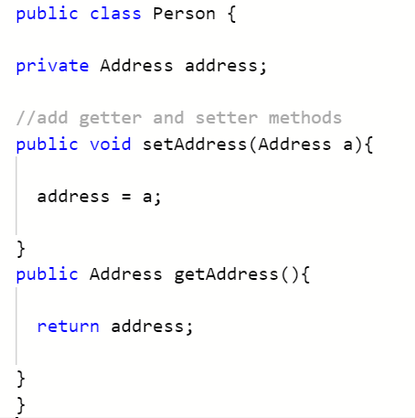
3. 1:1 Association – unidirectional – 1 Way only
Setter and Getter Methods
Person.java
Address.java
From Person to Address
Add the setAddress() and get Address() to Person

Slide 20
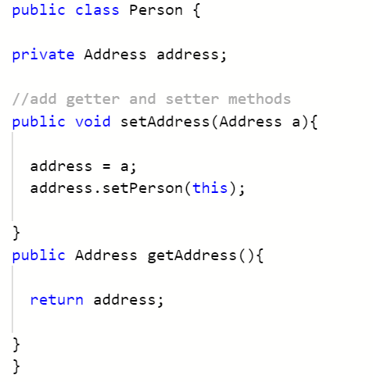
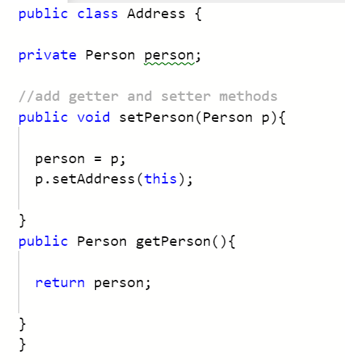
3. 1:1 Association – Bidirectional – 2 WayS
Setter and Getter Methods
Person.java
Address.java
1 – From Person to Address
2 – From Address to Person
Add setAddress() and get Address() to Person class
Add setPerson() and getPerson() to Address class

Slide 21
3. 1:1 Association
But how can we make sure that only one object will be related/referenced to maintain the 1:1 relationship?
We can add a conditional if statement in the setter method of the class to check if it has already been previously referenced/related.
If it was referenced already then it won’t be created again

Slide 22
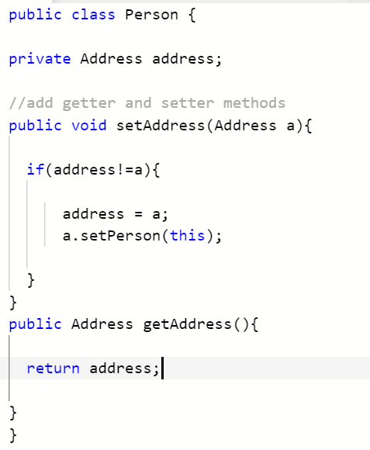
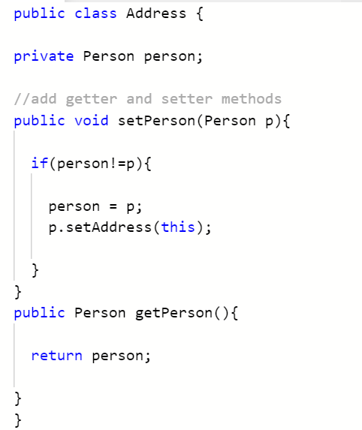
2 What is association?
1:1 – Bidirectional – 2 Ways – Ensuring the one to one relationship
Person.java
Address.java
0..1
0..1
Add if condition to setter method in Person class
Add if condition to setter method in Person class

Slide 23
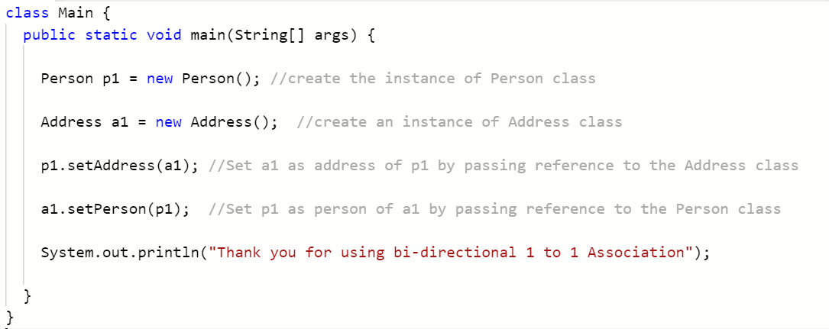
2 What is association? – Let’s use the Classes
Making use of associated classes in the main part of the program
Write the JAVA code of the driver (Main) class:
Define an instance of class Person called p1
Define an instance of class Address called a1
Set a1 as address of p1 by passing reference to the Address class
Set p1 as address of a1 by passing reference to the Person class

Slide 24
4. 1: m Association – one to many
Sometimes we will need to use a one to many association as it is possible that a person could be associated with multiple addresses.

Slide 25
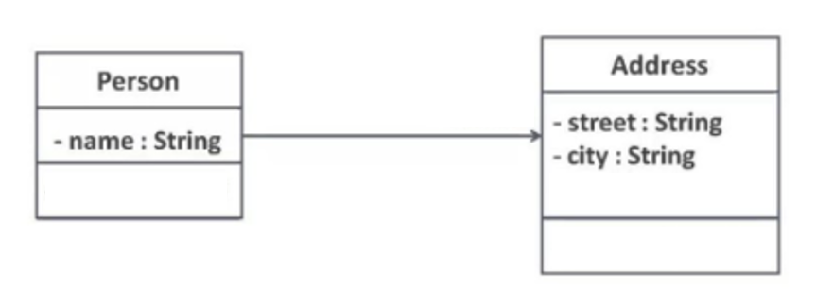
4. 1: m Association – one to many
0..1
0..*
A Person object relates in a one to many relationship with the Address object
Note: If an object instance of class Person is deleted, the instances of class Address will still exist

Slide 26
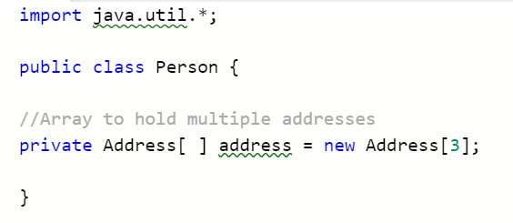
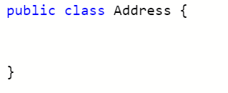
4. 1: m Association – one to many - Unidirectional
We need to use an array or list to hold the many instances of addresses associated with a person
0..1
0..*
Person.java
Address.java
0..1
0..*

Slide 27
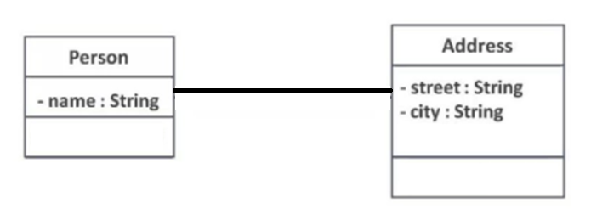
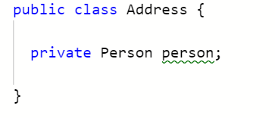
4. 1: m Association – one to many - Bidirectional
0..1
0..*
Make a reference back to the Person class from Address class.
We need to use a array or list to hold the many instances of addresses associated with a person
Person.java
Address.java
0..1
0..*

Slide 28
5. N: m Association – MANY to many - Bidirectional
Bidirectional N:M
One way of implementing it is for both classes to maintain collections of references to instances of the other class.
Again, operations need to be added that preserve consistency between the two collections of references.

Slide 29
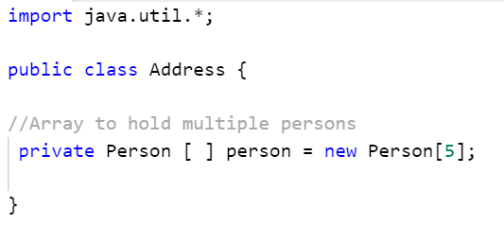
5. N: m Association – MANY to many – Bidirectional
We need to use an array or list to hold the many instances of addresses associated with a person
We need to use an array or list to hold the many instances of persons associated with a particular address.
0..*
0..*
Person.java
Address.java
0..*
0..*

Slide 30
KEY TERMS
CLASS
REFERENCE
ASSOCIATION
UNIDIRECTIONAL
BIDERECTIONAL

Slide 31


